Slide 1
ER Diagram

Slide 2
A Sample Database Application
A sample database application, called COMPANY
The COMPANY database keeps track of a company’s employees, departments, and projects.
The company is organized into departments. Each department has a unique name, a unique number, and a particular employee who manages the department. We keep track of the start date when that employee began managing the department. A department may have several locations.
A department controls a number of projects, each of which has a unique name, a unique number, and a single location.

Slide 3
We store each employee’s name, Social Security number, address, salary, sex (gender), and birth date. An employee is assigned to one department, but may work on several projects, which are not necessarily controlled by the same department. We keep track of the current number of hours per week that an employee works on each project. We also keep track of the direct supervisor of each employee (who is another employee).
We want to keep track of the dependents of each employee for insurance purposes. We keep each dependent’s first name, sex, birth date, and relationship to the employee.

Slide 4
Employees
Ssn | Birth_date | Name | Address | Salary | Gender | Department | Works_on
Department
Name | Number | Manager | Locations | Manager_start_date
Project
Name | Number | Location | Controlling_Department
Dependent
Employee | Depenedent_ Name | Gender | Birth_date | Relationship

Slide 5
ER model
The ER model describes data as entities, relationships, and attributes.
The basic object that the ER model represents is an entity, which is a thing in the real world with an independent existence.
Each entity has attributes—the particular properties that describe it.
For example, an EMPLOYEE entity may be described by the employee’s name, age, address, salary, and job.

Slide 6
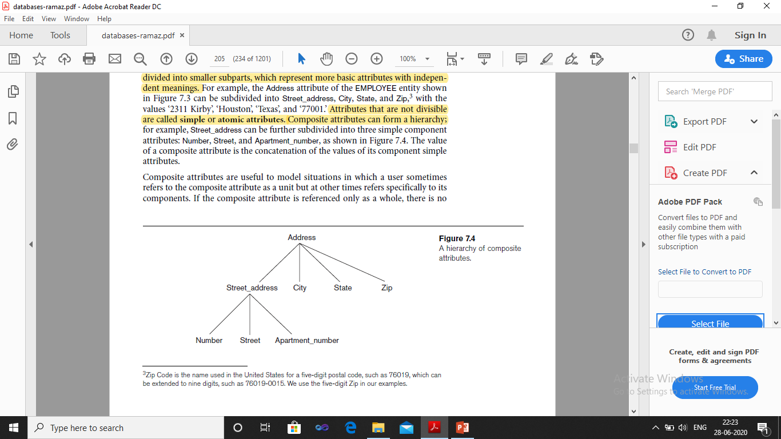
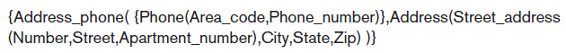
Several types of attributes occur in the ER model
Simple attribute
Composite attribute
Key attribute
Single-valued attribute
Multivalued attribute
Stored attribute
Derived attribute
Null values
Complex attribute

Slide 7
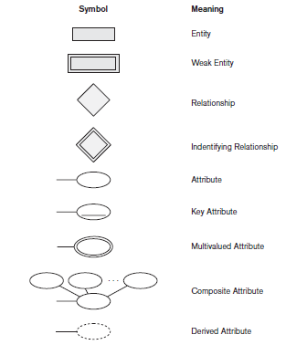

Slide 8
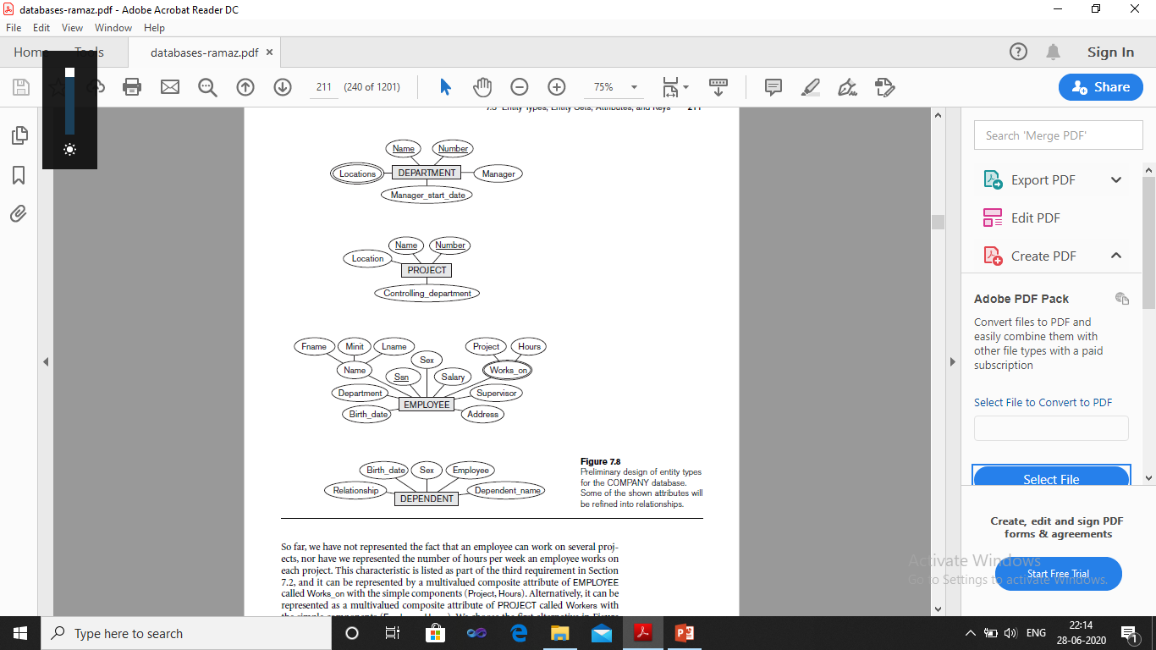
Initial Conceptual Design of the COMPANY Database

Slide 9
Entity Types and Entity Sets
A database usually contains groups of entities that are similar.
An entity type defines a collection (or set) of entities that have the same attributes. Each entity type in the database is described by its name and attributes.
The collection of all entities of a particular entity type in the database at any point in time is called an entity set.
For example, a company employing hundreds of employees may want to store similar information concerning each of the employees. These employee entities share the same attributes, but each entity has its own value(s) for each attribute.

Slide 10
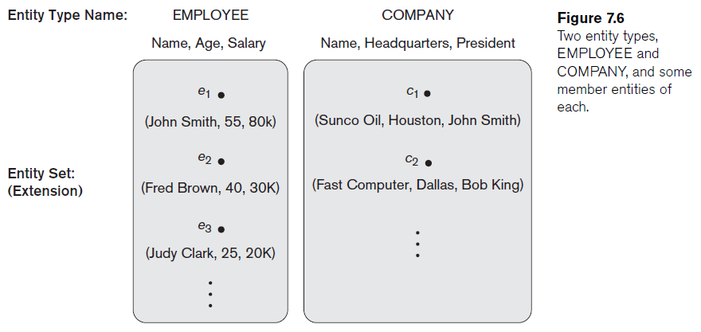

Slide 11
Key Attributes of an Entity Type
An important constraint on the entities of an entity type is the key or uniqueness constraint on attributes.
An entity type usually has one or more attributes whose values are distinct for each individual entity in the entity set. Such an attribute is called a key attribute, and its values can be used to identify each entity uniquely.
In ER diagrammatic notation, each key attribute has its name underlined inside the oval.
Specifying that an attribute is a key of an entity type means that the preceding uniqueness property must hold for every entity set of the entity type. Hence, it is a constraint that prohibits any two entities from having the same value for the key attribute at the same time. It is not the property of a particular entity set; rather, it is a constraint on any entity set of the entity type at any point in time.
Notes:
In our diagrammatic notation, if two attributes are underlined separately, then each is a key on its own.

Slide 12
Value Sets (Domains) of Attributes
Each simple attribute of an entity type is associated with a value set (or domain of values), which specifies the set of values that may be assigned to that attribute for each individual entity.
For Example, if the range of ages allowed for employees is between 16 and 70, we can specify the value set of the Age attribute of EMPLOYEE to be the set of integer numbers between 16 and 70.

Slide 13
Relationship
Relationship represents how two or more entities can be associated with each others.
A relationship type R among n entity types E1, E2, ..., En defines a set of associations—or a relationship set—among entities from these entity types.
Each relationship instance ‘r’ in R is an association of entities.
In ER diagrams, relationship types are displayed as diamond-shaped boxes, which are connected by straight lines to the rectangular boxes representing the participating entity types. The relationship name is displayed in the diamond-shaped box

Slide 14
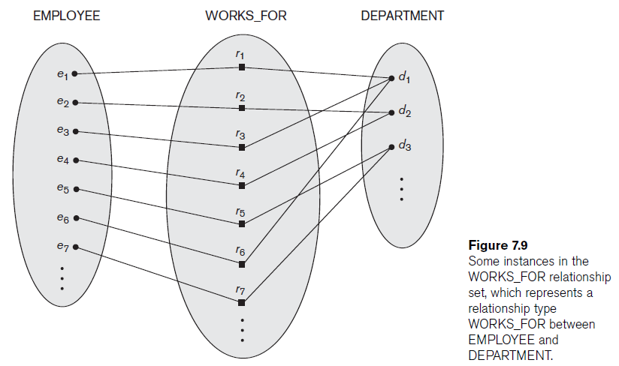

Slide 15
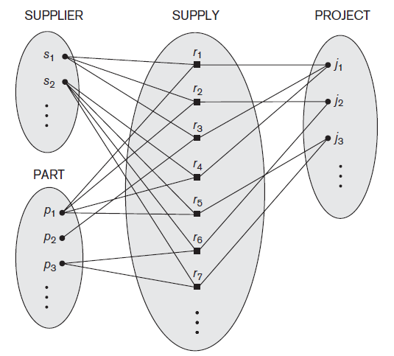
Degree of a Relationship Type: The degree of a relationship type is the number of participating entity types. Hence, the WORKS_FOR relationship is of degree two.
A relationship type of degree two is called binary, and one of degree three is called ternary.

Slide 16
Role Names and Recursive Relationships
Each entity type that participates in a relationship plays a particular role in the relationship. The role name signifies the role that a participating entity from the entity type plays in each relationship instance, and helps to explain what the relationship means.
For example, in the WORKS_FOR relationship type, EMPLOYEE plays the role of employee or worker and DEPARTMENT plays the role of department or employer.
In some cases the same entity type participates more than once in a relationship type in different roles. In such cases the role name becomes essential for distinguishing the meaning of the role that each participating entity plays. Such relationship types are called recursive relationships.

Slide 17
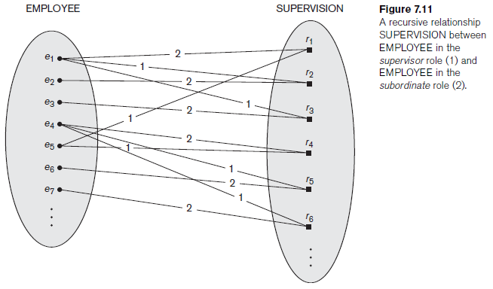

Slide 18
Constraints on Binary Relationship Types
Two main types of binary relationship constraints:
cardinality ratio
Participation constraint.

Slide 19
Cardinality Ratios for Binary Relationships
The cardinality ratio for a binary relationship specifies the maximum number of relationship instances that an entity can participate in.
For example, in the WORKS_FOR binary relationship type, DEPARTMENT:EMPLOYEE is of cardinality ratio 1:N, meaning that each department can be related to (that is, employs) any number of employees, but an employee can be related to (work for) only one department.
The possible cardinality ratios for binary relationship types are 1:1, 1:N, N:1, and M:N.
Cardinality ratios for binary relationships are represented on ER diagrams by displaying 1, M, and N on the diamonds.

Slide 20
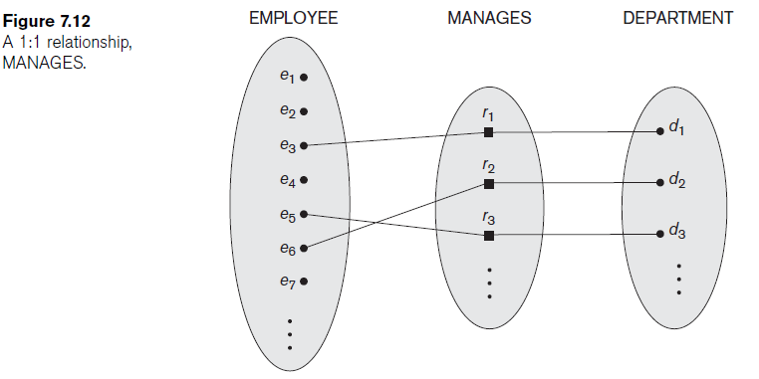

Slide 21
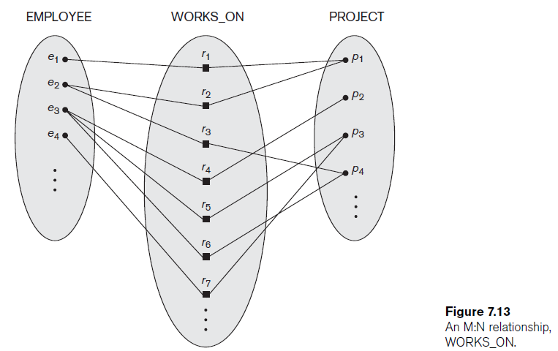

Slide 22
Participation Constraints
The participation constraint specifies whether the existence of an entity depends on its being related to another entity via the relationship type.
This constraint specifies the minimum number of relationship instances that each entity can participate in, and is sometimes called the minimum cardinality constraint.
There are two types of participation constraints
  total participation constraint
  Partial participation constraint
Total participation is also called existence dependency.
In ER diagrams, total participation (or existence dependency) is displayed as a double line connecting the participating entity type to the relationship, whereas partial participation is represented by a single line

Slide 23
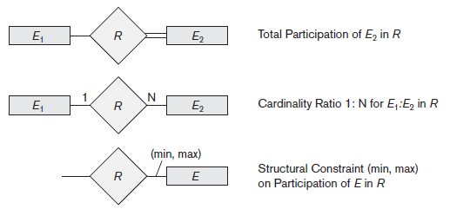

Slide 24
Weak Entity Types
Regular entity types that do have a key attribute are called strong entity types.
Entity types that do not have key attributes of their own are called weak entity types.
Entities belonging to a weak entity type are identified by being related to specific entities from another entity type in combination with one of their attribute values. We call this other entity type the identifying or owner entity type.
The relationship type that relates a weak entity type to its owner the identifying relationship of the weak entity type.
A weak entity type normally has a partial key, which is the attribute that can uniquely identify weak entities that are related to the same owner entity.

Slide 25
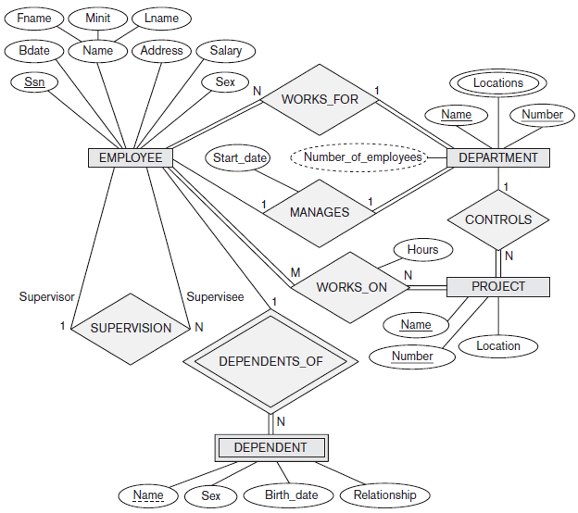

Slide 26
ER Diagram for BANK database
Each bank can have multiple branches, and each branch can have multiple accounts and loans.
Bank: Name, Code, Address
Branches: Address and a branch Number
Account: Account type, balance and account number
Loan: Lan type, amount and loan number
Customer: Name, address, Phone and unique number(SSN)

Slide 27
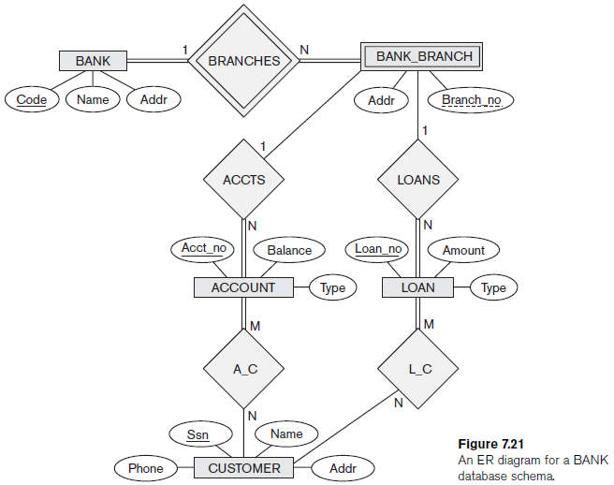

Slide 28
a. List the strong (non weak) entity types in the ER diagram.
b. Is there a weak entity type? If so, give its name, partial key, and identifying relationship.
c. What constraints do the partial key and the identifying relationship of the weak entity type specify in this diagram?
d. List the names of all relationship types, and specify the (min, max) constraint on each participation of an entity type in a relationship type. Justify your choices.
e. List concisely the user requirements that led to this ER schema design.
f. Suppose that every customer must have at least one account but is restricted to at most two loans at a time, and that a bank branch cannot have more than 1,000 loans. How does this show up on the (min, max) constraints?

Slide 29
Consider the ER schema for the MOVIES database
Assume that MOVIES is a populated database. ACTOR is used as a generic term and includes actresses. Given the constraints shown in the ER schema, respond to the following statements with True, False, or Maybe.
Assign a response of Maybe to statements that, while not explicitly shown to be True, cannot be proven False based on the schema as shown. Justify each answer.

Slide 30
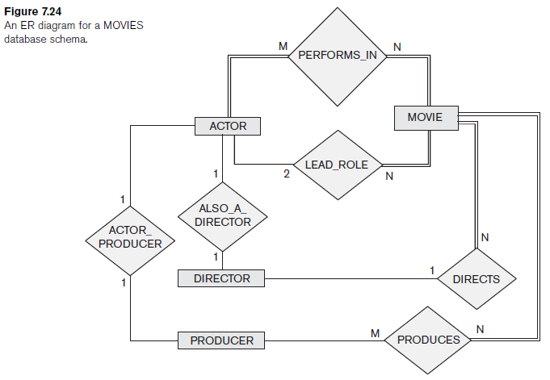

Slide 31
There are no actors in this database that have been in no movies.
There are some actors who have acted in more than ten movies.
Some actors have done a lead role in multiple movies.
A movie can have only a maximum of two lead actors.
Every director has been an actor in some movie.
No producer has ever been an actor.
A producer cannot be an actor in some other movie.
There are movies with more than a dozen actors.
Some producers have been a director as well.
Most movies have one director and one producer.
Some movies have one director but several producers.
There are some actors who have done a lead role, directed a movie, and produced some movie.
No movie has a director who also acted in that movie.

